Slide 1
Version control

Slide 2
Explain the purpose of version control.
Initialise a repository and inspect its status.
Stage and commit changes with clear messages.
Create and switch between branches.
Connect to a remote and push/pull changes.
Explain a basic collaborative Git workflow.

Slide 3
Git basics
Version control

Slide 4
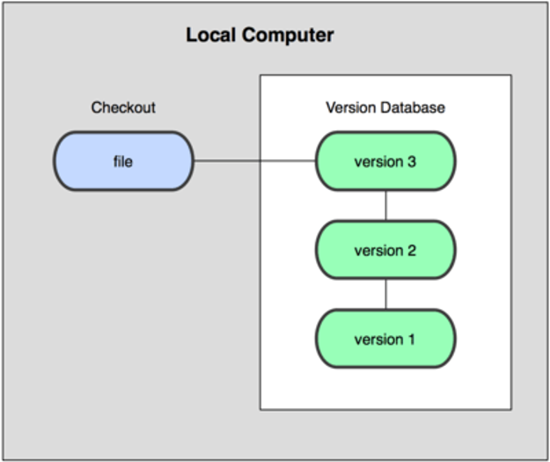
Version control
Version control is a system that records changes to files.
A VCS allows you to manage file history allowing you to:
Roll back to previous states of a file if something goes wrong.
Maintain change logs allowing you to compare versions.
The simplest form of version control systems are local. For example, rcs in Mac OS x.

Slide 5
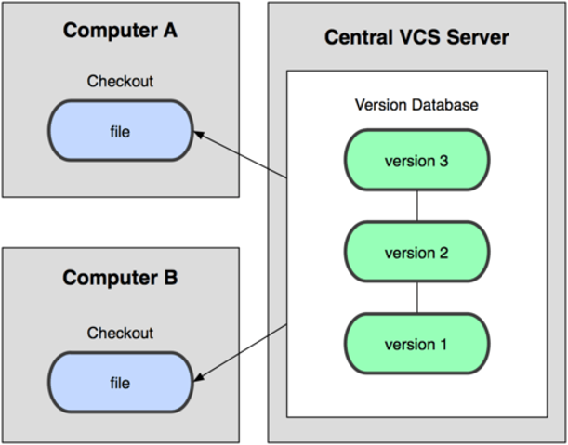
Centralised version control systems
Central VCS allow multiple developers to collaborate on projects. For example, CVS, Subversion, and Perforce.
Single server that contains all versioned files:
Clients that check out files from this source.

Slide 6
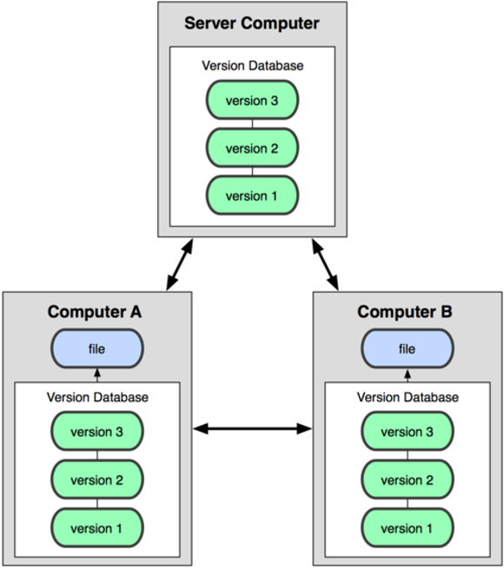
Distributed version control systems
DVCS do not just check out the most local snapshot of a file:
They mirror the repository.
So, each checkout is like a backup of the repository.

Slide 7
GIT as a DVCS
GITs origin are in Linux Development, and it is open source.
Its goals were to create a DVCS system that was:
Fast.
Simple.
Strong support for non-linear development.
Fully distributed.
Able to handle large projects, like the Linux kernel, efficiently.

Slide 8
Why use source control?
Keep track of codes and changes:
One copy of the code everyone has access to.
No more mailing around code and confusion trying to integrate it.
Automated version management.
Allows for multiple people to edit a single project at the same time:
Push changes to the central repository.
Everyone can pull changes from others.
Merge together changes in files where there are conflicts.
Branch code to work on specific parts:
Version 2.3 doesn’t need to die because someone else wants to look at version 3.

Slide 9
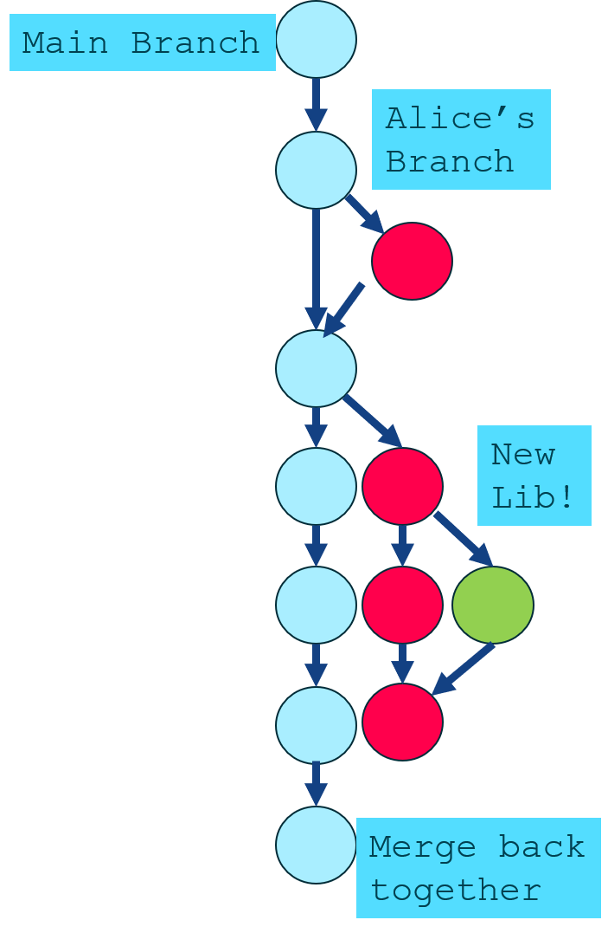
Source control using Git
Git is a popular distributed source control method.
Free hosting sites available:
Bitbucket
Github
Step 1: Create a repository on a hosting site, or your own server.
Step 2: Check out the repository to your own machine.
Step 3: Add some code.
Step 4: Commit your changes to the local repository.
Step 5: Push changes to the remote repository.
Notes:
Command line:
git clone <<repo>> - check the repository out to your machine
git add <<file>> - add a file
git commit –m “message”
git push
git pull

Slide 10
Git configuration: Setting the user
Git keeps track of who performs version control actions. Git must be configured with your own name and e-mail.
To configure Git with your name and e-mail, we use the following commands:
The values can then be accessed using:
You can list all the configurations with:
% git config --global user.name "Your Name"
% git config --global user.email "mail@example.com"
% git config user.xxx
% git config --list
Notes:
Git config user.name
Git config user.email
--global is the user settings
--system is for ALL users of the PC
Without a switch it’s a project level config setting

Slide 11
Activity: Git user configuration
Use the command line to configure Git with your username and email.
Check the settings to ensure these are set.

Slide 12
Git commands: Etymology
Git commands all follow the same convention:
The word ‘git’.
Followed by an optional switch.
Followed by a Git command (mandatory).
Followed by optional arguments.
git [switches] <commands> [<args>]
git –p config –global user.name "Dave"
Notes:
The -p switch paginates the output if needed.

Slide 13
Getting started with Git
When you first launch Git, you will be at your home directory.
  ~ or $HOME
Through the Git Bash terminal, you can then move through and modify the directory structure.
Command | Explanation
ls | Current files in the directory.
mkdir | Make a directory at the current location.
cd | Change to the current directory.
pwd | Print the current directory.
rm | Remove a file (optional –r flag to remove a directory).

Slide 14
Activity: Git bash — Making a directory
Launch your Git command line:
Ensure you are at your home directory.
Find the corresponding directory using your GUI file explorer.
Create a directory called gitTest.
Navigate within the directory using the command line.
Create a sub folder.
Navigate back to home.
Remove the gitTest directory.
Once you have completed all other tasks, type history.

Slide 15
Git help
git help
git help tutorial
git help everyday
Notes:
Spacebar to continue
F for forward
B for back
Q for quit

Slide 16
Activity: Git help
Use your command line to access Git help to find out about:
help.
glossary.
-a.
config.
-g.

Slide 17
Summary
Git is a multi-platform version control tool.
It uses a common command line interface on all major platforms.
The Git command line is based on UNIX.

Slide 18
Git repositories
Version control

Slide 19
Git repositories
Understanding repositories
  Initialising repos
  Adding files to repos
  Committing
Working with file staging
  How to stage and un-stage a file
Using the Git GUI in conjunction with GIT BASH

Slide 20
Git key concepts: Repos
Git holds assets in a repository (repo):
A repository is a storage area for your files.
This maps to a directory or folder on your file system.
These can include subdirectories and associated files.
The repo requires no server but has created a series of hidden files:
Located in .git folder.
$mkdir firstRepo
$cd firstRepo
$git init
Notes:
Git inti (initialisation) command tells git to get ready to start watching a directory for any changes made.
Git stores all of its information in a subdirectory called .git
In gitbash type ls
It will not show hidden (dot) folders and files
Type: ls –la
This will show you the hidden folders
To see inside the .git folder from where you are type:
Ls –la .git
Don’t edit stuff in here directly
This is git’s workspace

Slide 21
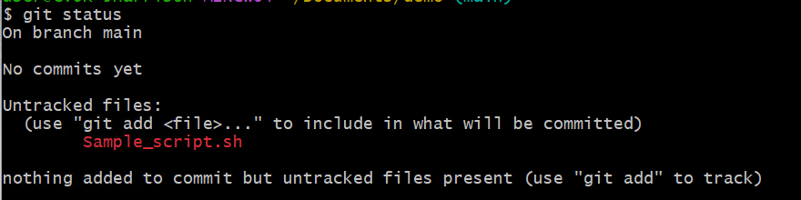
Git status
You can see the status of your Git repository:

Slide 22
Activity: Creating a Git repository
Create a folder at the ~ called firstRepo.
Initialise it as a git repository.
Check the status of the repo.
Use the touch command to create a file called myfile.bat.
Check the status of the repo.

Slide 23
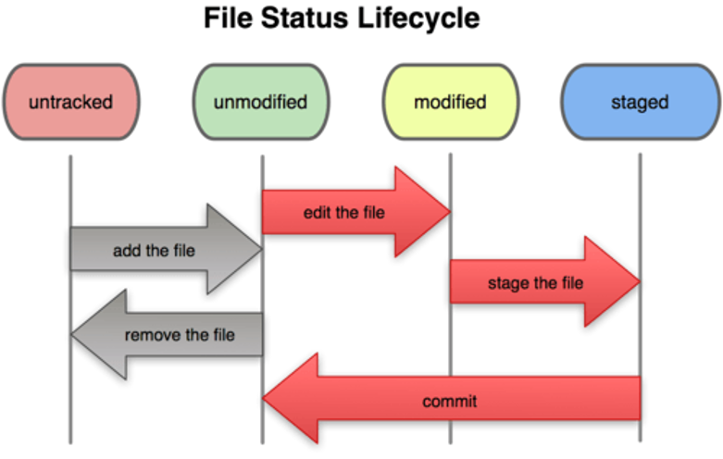
Recording changes to a repository
Each file in a git directory can be tracked or untracked:
Tracked files are files that were in the last snapshot. They can be unmodified, modified, or staged.
Untracked files are everything else not in your last snapshot or staging area.
Notes:
The main tool you use to determine which files are in which state is the git status command. If you run this command directly after a clone, you should see something like this:
$ git status
On branch main nothing to commit, working directory clean
Git has 3 trees that form its architecture: working tree, staging, and (committed) repository
We can work on 10 files in our working directory, choose to stage only 5 of them and commit those 5 as a single change set

Slide 24
Tracking files in a Git repo
To track a file, we must add it to the repo:
Then we must commit the file — adding to the repository timeline:
This will launch the vi editor. We must then:
Switch to input mode (i).
Enter a commit message.
Hit ESC to complete the message.
Enter ZZ or :wq to exit the vi editor.
The repo is now updated.
$ git add FILENAME
$ git commit
$ git status
$ git log
$ git log --stat
Notes:
Git log shows the commit ids (a 40 digit hex number or SHA that uniquely represents that change set)
--stats shows the number of insertions an deletions
Git log –n 3 shows thee last 3 commits
Git log –since=2019-02-10
Git log –until=2019-02-11
Git log –author=“Victoria” // just put in part of the authors name and it should work
Git log –grep=“initial”
The commit contains the id, the author and date, the changes and the parent id of the change set

Slide 25
Adding files
To add a new file, use the ‘add’ command:
Git status will show the newly added file:
# a single file
$ git add specific_file_name.ext
# To add all changed files, deleted and untracked
$ git add .
$ git add --all
$ git add -a
On branch main
Changes to be committed:
(use "git reset HEAD <file>..." to unstage)
modified: sample_script.sh
Notes:
git add . (note the dot) - will walk through all sub folders and add to staging

Slide 26
Committing files
To commit the changes, use the ‘commit’ command:
The –m flag is used to set a message.
This is now saved to the local version of your repository.
$ git commit -m "More content for Sample - git"
[main 93e8300] More content for Sample - git
1 file changed, 0 insertions(+), 0 deletions(-)
Notes:
Use meaningful, structured commit messages. Perhaps include tracking numbers, bug report info. Make sure they are detailed enough as to be useful.
Avoid ambiguous comments such as “Bug fixed”

Slide 27
Git key concepts: Commits
A commit is a saved change that adds your changes to the history of your repository and assigns a commit name to it.
The change is not sent to a central repository:
Other people can pull the change from you.
Or you can push the change to some other repository.
There is no automatic updating.
Every commit requires a log message:
You can add a message by adding -m "your message“.
The message can be any valid string.
You can also specify multiple paragraphs by passing multiple -m options to Git commit.

Slide 28
Writing a commit message
Short and descriptive.
Uses action words (add, fix, update, remove, refactor).
Focuses on the change, not the implementation details.
Explains the reason if it's not obvious.
One commit = one logical change.
Notes:
A commit message is a short description of the changes you've made to your code. A good commit message should be clear, concise, and explain what was changed. Using action words such as Add, Fix, Update, or Remove helps others quickly understand the purpose of the commit. Avoid vague messages like 'stuff changed' or 'update' because they don't provide useful information when reviewing a project's history

Slide 29
Activity: Git tracking and committing to a repo
Add the myfile.bat to the tracked files of the repo.
Commit it.
Utilise vi to set its commit message.
Check the status of the repo.
Create a file called newfile.bat.
Add it to the tracked files.
Check the status.
Commit the file using the –m flag to add a message without using vi.
Check the status using the stat flag.
Notes:
HEAD – git maintains a reference pointer called HEAD. It points to a specific commit in the repository
Head always points to the tip of the current branch in our repository (not the working directory or the staging area)
If we checkout a branch our head now points to its tip. Think of the head pointer as being the place where our next commit will be recorded
When you type in git log it’s the same as typing in git log HEAD
Git diff will show us the differences between the repository (HEAD) and our working directory

Slide 30
Summary
Repositories are version-controlled resources that require no server.
Files within a repo can be added to the repo or ignored.
Tracked files and their status will be added to the .git resources.
Files can be worked with and committed. Once committed, their log history and the user status is maintained.

Slide 31
Updates and tracking
Version control
Notes:
Understanding file difference and hunks:
Working with the diff command
Checking out and deleting files:
Executing Dry Runs

Slide 32
Git diff
The diff command allows Git to examine a file in a repo and identify what has changed:
Output shows the files being compared:
The string @@ -1 +1,2 @@ is known as a hunk.
Hunk shows there is a difference in the two files.
$ git diff
diff --git a/cache.manifest b/cache.manifest
index 84bc776..afd8ac9 100644
--- a/cache.manifest
+++ b/cache.manifest
@@ -1 +1,2 @@
#Comment
+"index.html"
Notes:
Specifically the hunk is saying:
Take the original file at the first line -1
Then apply the following two lines (+1,2)
The + shows it to be a pre-append

Slide 33
Activity: Git diff
Create a new directory and repo in your home directory called gitDiff.
Use the echo command to create a new file called cache.manifest.
  With the content: ‘# Cache Manifest v1.1’.
Add and commit the file.
Use echo and the >> operator to add the content to the end of the file.
Execute a status command and note what happens.
Use the diff command to understand the changes.
Commit the change.
Notes:
Git diff
Or//
Git diff myfile.txt
Git diff –stage // tells git to look in the staging index and compare those files to the files in the repository
Echo ‘# Cache Manifest v1.1’ > cache.manifest
Echo ‘index.html’ >> cache.manifest
Cat cache.manifest // to read the file

Slide 34
Staging with Git
The Git staging area contains a version of the working directory:
That we will commit.
Git allows us to continue to make changes to staged files.
Using the status command will check the working and staging areas:
The diff command has an optional --staged flag.
This can also be managed and visualised in git gui.
Working area
Staging area
Commit history

Slide 35
Demonstration staging with Git
When you add a file to a repo it is now tracked by Git. You can then commit the new file added to the repo.
When you change a tracked file, it becomes modified. Something very interesting happens when you have multiple changes in a staged file
Demonstration:
Using add and stage.
Examining hunk differences using diff.
Committing changes.

Slide 36
Recording changes to a repository
Each file in a Git directory can be tracked or untracked:
Tracked files are files that were in the last snapshot. They can be unmodified, modified, or staged.
Untracked files are everything else not in your last snapshot or staging area.
Notes:
The main tool you use to determine which files are in which state is the git status command. If you run this command directly after a clone, you should see something like this:
$ git status
On branch main nothing to commit, working directory clean

Slide 37
Activity: Working with staging
Create a new directory called wipeout in your home folder.
Initialise as a repo.
Create a file called f1 and add a line of text to it.
Stage the file for commit and check the status.
Commit the repo.
Create a second empty file with one line of text and add it to the repo.
Add an additional line of text to the file.
Use the diff command and note what it is telling you.
Stage the file.
Use the diff command again.
Commit the changes.

Slide 38
Un-staging files and reverting changes
Once staged, files can be stepped backwards with a reset:
Changes to files can be undone with the checkout command:
Untracked files can be removed with the clean command:
The reset command allows you to undo all changes since the last commit
$ git reset <filename>
$ git checkout <filename>
$ git clean –n
$ git reset --hard
Notes:
-f flag performs a dry run
-xf forces the deletion of untracked file in a directory removes untracked files and directories
Git clean –n // is a dry run and displays the untracked files that would be removed
To delete the files type:
Git clean –f // to force deletion
Git checkout – index.html // the double dash says to git, this is NOT a branch. Useful if we are wanting to checkout a folder but we also have a branch with the same name.. Git would normally checkout the branch not the folder unless we use the double dash to mean stay in the current branch.
Checkout – go get the thing with this name from the repo and replace the same thing in the working directory with it so that my working directory item looks the same as that item in the repo
You might want to unstage a file when you are trying to gather all relevant files for a commit but you accidentally add one that is related to a different commit group and message.
Git reset HEAD resources.html // go get the version from where HEAD points and make staging look the same (can leave out HEAD) Your file is back to modified but unstaged and its changes are preserved.
To change what has been committed into the repo is harder to do as it would affect the SHA values which would break the chain of history but we can amend the last commit.
Make your additional changes and then add to staging and then:
Git commit - - amend –m “My message here”
You can also use this to change your message if you didn’t like the message that you just used.
You can checkout items from a particular revision using:
Git checkout 12345678910 - - index.html // means checkout from the commit with SHA 123etc in the current branch - - , the file called index.html. It gets put straight into staging rather than the working directory like above
Get reset // use with caution. It allows us to specify where the HEAD pointer should point to

Slide 39
Adding multiple files to the staging area
Typically, multiple files are added to the staging area:
We might want to check the outcome of an add action is as expected:
The --dryrun flag allows you to check the outcome of an add
Then add as normal. You can view the log on a single line.
$ touch file1 file2 file3 file4
$ git add --dry-run .
$ git log --oneline
Notes:
Git add –dry-run . //this lists the files that will be added but doesn’t do the add

Slide 40
Activity: Cleaning and resetting
Within the wipeout repo, add a new line of text to f1.
Use diff and status to understand the current status of files.
Reset the file and check the outcome via diff and status.
Create files f2, f3, and f4. Add a line of text to f2.
Add f2 to the repo.
Use status to understand the changes.
Use reset to undo the changes in this lab.
Use clean to remove the untracked files.

Slide 41
Deleting and renaming files in Git
We use the rm command in git to remove files:
Then run status to check:
Renaming can be achieved with the mv command:
$ git rm file1
$ git commit –m "file1 removed"
$ git mv file new_name
Notes:
When renaming files the git is optional

Slide 42
Tracking files in a Git repo
To track a file, we must add it to the repo:
Then we must commit the file, adding to the repository timeline:
This will launch the vi editor. We must then:
Switch to input mode (i).
Enter a commit message.
Hit ESC to complete the message.
Enter ZZ to exit the vi editor.
The repo is now updated:
$ git add FILENAME
$ git commit
$ git status
$ git log
$ git log --stat

Slide 43
When to commit?
Commit little and often when using Git.
It is normal to commit when:
Adding or deleting a file.
Renaming a file.
Updating a file known to be in a good working state.
When you anticipate being away from work.
When you introduce ‘questionable’ code.

Slide 44
Git key concepts: Commits
A commit is a saved change that adds your changes to the history of your repository and assigns a commit name to it.
The change is not sent to a central repository.
Other people can pull the change from you.
Or you can push the change to some other repository.
There is no automatic updating.
Every commit requires a log message:
You can add a message by adding -m "your message“.
The message can be any valid string.
You can also specify multiple paragraphs by passing multiple -m options to Git commit.

Slide 45
Activity: Git tracking and committing to a repo
Add the myfile.bat to the tracked files of the repo.
Commit it.
Utilise vi to set its commit message.
Check the status of the repo.
Create a file called newfile.bat.
Add it to the tracked files.
Check the status.
Commit the file using the –m flag to add a message without using vi.
Check the status using the stat flag.

Slide 46
Summary
Git diff
Un-staging
Dry runs
Deleting files
Notes:
To wrap long lines of html in bash try minus capital S (- S)
Use git diff –color-words myhtmlpage.html
This will show old edits (deletions) in red and replacement values in green
Git commit –am “My commit message here” // the a adds everything that is tracked and modified
Good for adding lots of tracked modified files straight to commit repo rather than having to stage them first. This does not add deletions or untracked files from your working directory.

Slide 47
Branching
Version control
Notes:
Logging a – deeper dive:
Patch and Tree views
How branches work:
The HEAD and moving it
Creating Branches:
Managing and switching branches
Committing changes to branches
Merging Branches

Slide 48
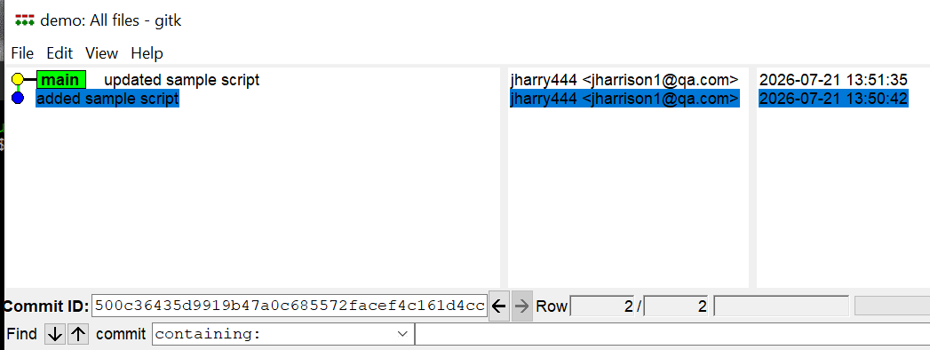
Git logging: A deeper dive
When we use git log, we see a detailed history of the history log:
Provided in reverse chronological order.
Each entry in the log has a SHA1 ID making each commit unique:
This is a cryptographically strong ID.
The commit also holds author and date meta information:
Plus a log message.
Each commit always points back to its parent:
We can visualise the history with gitk.

Slide 49
GITK: Patch and tree views
The GITK viewer has two ways to see the changes.
The patch view shows the files that were patched in a commit.
Showing how the files were changed.
Shown as a flat directory reflecting the changes.
The tree view shows the files changed and the metadata.
It represents the directory structure of the project, but not the details of the hunks.

Slide 50
Commits occur in a line created when we first initialise the repo:
Git also creates a default branch called main.
Main is a pointer to the last commit in the branch.
The HEAD represents our current location.
Normally in the same place as main.
Comm2
Comm1
Comm3
Comm0
Main
(latest commit)
HEAD

Slide 51
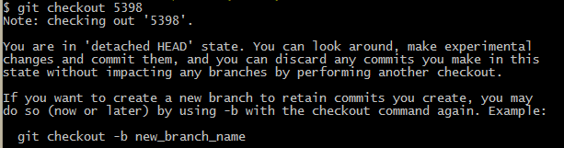
Git checkout
The HEAD can move — checking out previous commits.
You need the SHA1 id to achieve this. Use log to find it
Then use the first four characters of the ID to checkout what you want:
$ git log --oneline
$ git checkout YOUR_SHA1ID

Slide 52
Detaching the HEAD
Normally, the HEAD is attached to a branch, but we can move it.
This is what we did with checkout.
When we move the HEAD from the main, git considers it detached.
Comm2
Comm1
Comm3
Comm0
(latest commit)
HEAD

Slide 53
Activity: Working with the HEAD
In your most recent repo, use the one-line log to locate the SHA1 history:
Move the HEAD to the start of the commit history via checkout.
Check the log history.
Use touch to create a new file.
Add it to the repo.
Commit the changes.
Use checkout to return to the main.
Check the contents of your directory and note what has happened to the new file.
Check the log history.
Notes:
Take a copy of all the SHA1s for your commits within the wipeout repo
Keep in a notepad file
Gti checkout ###Initial Commit sha
Git log - -oneline
Touch someNewFile.txt
Git status
Git add someNewFile.txt
Git commit –m “some new file added after initial commit”
Git status
Git log main // head has moved but tip of main hasn’t
Git checkout ###latest main sha
// new file has disappeared
Git log - - oneline

Slide 54
Tagging
Tagging allows you to add metadata to a repository.
Often used for versioning:
You can search for tag patterns using the –l flag:
You can create an annotated tag with the –a flag:
$ git tag
v0.1
v1.3
$ git tag -l 'v1.4.2.*'
v1.4.2.1
v1.4.2.2
$ git tag -a v1.4 -m 'my version 1.4'
$ git tag
v0.1
v1.3
v1.4
Notes:
A tag reference for the SHA-1 object name of the commit object is created (i.e. a lightweight tag).
Tag objects (created with -a, -s, or -u) are called "annotated" tags; they contain a creation date, the tagger name and e-mail, a tagging message, and an optional GnuPG signature. Whereas a "lightweight" tag is simply a name for an object (usually a commit object).
Git tag v2.0 –m “Committing a tag for version 2” sha## // first 4 chars of sha will do for the object / commit you are referring too
Lightweight tags: A tag that is attached to an existing commit. This merely functions as a pointer to a specific commit, and as such it ‘piggybacks’ on that commit’s hash as identification. This type of tag does not allow you to store any information that specific to the tag.
Annotated tags: A tag that has its own commit hash and is, as such, stored as a separate object in git. This tag allows you to store information that is related to this specific tag. You can add a tag message, GPG sign it, and the tagger is stored.
If you use tags as code is reviewed: annotated tags give you separation between tagger (reviewer and/or releaser) and author/committer.
The –m flag creates an annotated tag.
Git tag my_new_head_tag // creates a lightweight tag – no –m or –a
Git show-refs –d - - tags //shows all tags – annotated tags appear twice. They show their own commit id and the commit id of the commit they point to

Slide 55
Activity: Git tagging
Re-run your commands from the previous activity.
Create a suitable tag on your first commit.
Move the HEAD back to the main.
Run gitk to explore the tag.
Use the one-line log to find a different SHA1 ID.
Create another tag (no need to move the head this time).
Check the outcome in gitk.
Use Git show and the tag name in bash to see the diff history.
Checkout the second tag you created.
$ git tag where_it_all_began –m “Committing a tag at the start”
Notes:
git tag v2.0 –m “Committing a tag for version 2” sha## // no need to move to the commit
Git tag some_tag // a lightweight tag at the head
Git show some_tag
Git checkout some_tag
Git status
Git checkout main

Slide 56
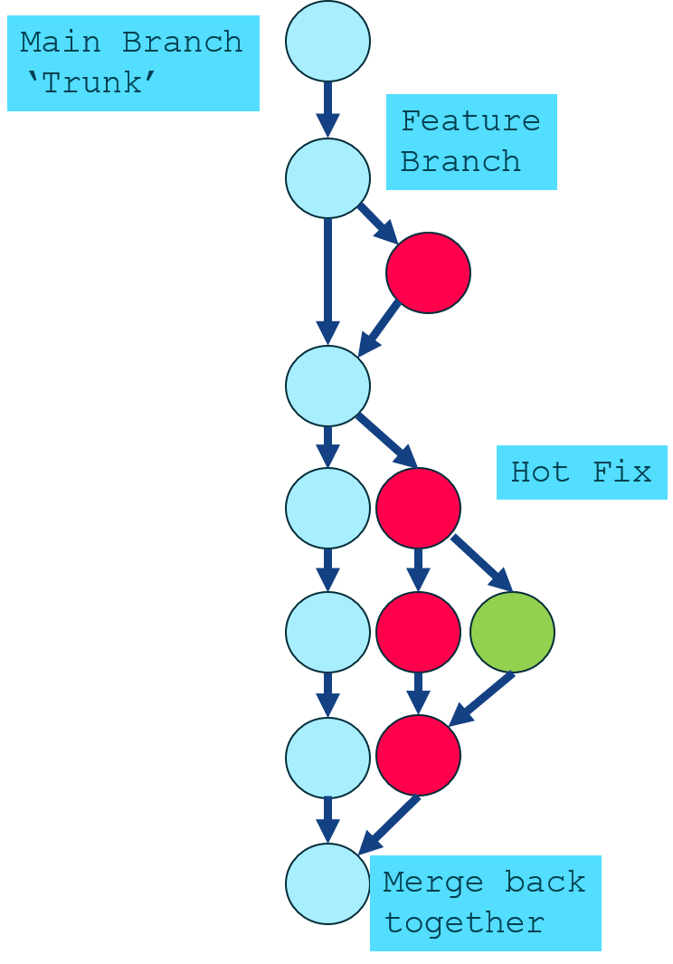
Git key concepts: Branching
Branches are other ‘paths’ or ‘lines’ of development.
Imagine that you’re making a website for a client, and it consists of an HTML file and a CSS file. You work on these two files in a default repository. This default repository is also conveniently associated with a default branch, which is often called ‘main’, or ‘trunk’.

Slide 57
Why and when to branch: New features
The main branch often represents the working code base (in other words, it works!).
So, we don’t hack on the main.
Branching is where we can safely introduce new code.
You can work and test in the branch and only merge once you are ready.

Slide 58
Why and when to branch: Hot fixes
Branches isolate changes from the code base:
You can navigate to any prior commit and check it out.
From that point, create a new branch.
You can then work on the fix and merge when ready.
The above code creates a new branch from a previously defined start point. The start point can be a branch, tag, or SHA1 ID.
$ git checkout –b hotfix thepast

Slide 59
Git branching
Branching allows you to diverge from the main line of development without doing accidental damage to the main line.
Git branches are very lightweight compared to other version control systems. Git encourages a workflow that allows you to branch and merge
Branches build on core Git features:
When you commit you have a snapshot of current content.
Plus zero or more pointers to the current commits.
  Based on this repository or a parent repository.
$ git branch testing

Slide 60
Branches
Branches allow for teams to add new features and work in parallel without adding ‘dangerous’ code and changes to the main branch of the repository.
The trunk (main) should be kept error-free.
# create a branch
$ git branch [name]
# list all the branches
$ git branch --list
# delete a branch
$ git branch –d [name]
# switch to a branch
$ git checkout [name]
# push to branch on remote
$ git push --set-upstream origin
Notes:
If the work on a branch is no longer needed it can be deleted
You need to be very careful – git really deletes the branch. Git does protect us from deleting the branch we are currently on. If there are uncommitted changes in the branch you may need to use the –D flag
https://www.atlassian.com/git/tutorials/using-branches is a good tutorial for branches
To delete a remote branch execute the following:
git push origin --delete branchname
Or
git push origin :branchname
This will push a delete signal to the remote origin repository that triggers a delete of the remote branchname branch.

Slide 61
Merging branches: Types
There are two types of merge:
Fast-forward: If there are no changes on the main that will conflict, then the head is updated to the end point of the branch.
Three-way merge: A new point is created with the two branches merged together.
# switch back to the main branch
$ git checkout main
# merge the branch
$ git merge [branch name]

Slide 62
Merging branches
Git merges the traffic into the current branch. So, make sure you are on the correct branch!
The diff command can be used to explore the differences between branches:
The output shows the difference between branches:
The order of the output matters — the main is shown first.
Showing that branch2 will be merged into the main.
$ git merge <branchname>
$ git diff <main>...<branch2>
Notes:
Make sure you are on the target branch before merging.

Slide 63
Demo: Branches, committing, and checking out
In this demonstration we will:
Do work on a website.
Create a branch.
Work in the branch.
We will then do a hotfix:
Switch back to the production branch.
Create a branch to add the hotfix.
Test and merge the branch.
Switch back to the original story.

Slide 64
Activity: Making and deleting a branch
Create a new directory called DevOps off your home directory.
Initialise it as a Git repository.
Add a file called bar and commit it.
Use the branch command to see the current branches.
Create a new branch called ops and check it out.
Delete the main branch.
Notes:
Git branch ops
Git checkout ops
or//
Git checkout –b ops // this creates and checks out the branch in a single statement
Git branch –d featureA // you can’t delete the branch you are on
Git will warn you if you have un-merged changes on the branch. –D will force the deletion if you really want to
Git branch –d main /// but should I do this?
Git branch // to see remaining branches

Slide 65
Working with remotes
Version control
Notes:
Logging a – deeper dive:
Patch and Tree views
How branches work:
The HEAD and moving it
Creating Branches:
Managing and switching branches
Committing changes to branches
Merging Branches

Slide 66
Summary
Git is a time machine — your history is maintained in an indexed list.
Each entry has a SHA1 key.
You can branch from your code, allowing you to fix and edit code.
Stashing allows you to save WIP and commit at a later point.

Slide 67
Cloning
Cloning makes a physical copy of a Git repository:
It can be done locally or via a remote server (for example, GitHub).
You can push and pull updates from the repository.
The benefit of cloning repos is that the commit history is maintained. Changes can be sent back between the original and the clone.
Cloning is achieved with the clone command:
Or through the GUI.
The GUI branch visualiser gives us a very useful way to see the origins of branches.
$git clone source destination_url

Slide 68
Git on the server
You will either need to create or access a Gits.
When getting started with Git, a hosted solution is a great tool:
GitHub is the most common of these: https://github.com.
  User-centric solution.
  Uses SSH protocol or HTTPS.
  Bitbucket is also popular: https://bitbucket.org.

Slide 69
Cloning a repository
Cloning copies the entire repository to your hard drive. The full commit history is maintained.
To clone a remote repository:
To clone a specific branch:
$ git clone [repository]
$ git clone https://username@bitbucket.org/username/repositoryname
$ git clone –b branchName repositoryAddress

Slide 70
Working with remote repositories
Git projects are often held on remote repositories. These hold versions of a project or dependencies on the web/network
To see configured remote repositories run the git remote command:
If you have cloned a repository, you should see the origin.
To add a repository:
shortname becomes an alias for access to the repository
When you have your project at a point you want to share you have to push it upstream:
git remote add [shortname] [url]
$ git push origin main
Notes:
You can also specify -v, which shows you the URL that Git has stored for the short name to be expanded to.
If you want to rename a reference, in newer versions of Git you can run git remote rename to change a remote’s shortname.
$ git remote rename pb jordan
$ git remote
origin
jordan
It’s worth mentioning that this changes your remote branch names, too. What used to be referenced at pb/main is now at jordan/main.
If you want to remove a reference for some reason — you’ve moved the server or are no longer using a particular mirror, or perhaps a contributor isn’t contributing anymore — you can use git remote rm:
$ git remote rm jordan
$ git remote
origin

Slide 71
Pushing to the repository
To update the changes in the remote repository, use the ‘push’ command:
To set the branch to automatically push, use:
$ git push origin main
Counting objects: 3, done.
Delta compression using up to 4 threads.
Compressing objects: 100% (3/3), done.
Writing objects: 100% (3/3), 6.81 KiB | 0 bytes/s, done.
Total 3 (delta 2), reused 0 (delta 0)
To https://username@bitbucket.org/username/demo.git
03d97e5..93e8300 main -> main
$ git push --set-upstream origin main
Notes:
You can also specify -v, which shows you the URL that Git has stored for the short name to be expanded to.
If you want to rename a reference, in newer versions of Git you can run git remote rename to change a remote’s shortname.
$ git remote rename pb jordan
$ git remote
origin
jordan
It’s worth mentioning that this changes your remote branch names, too. What used to be referenced at pb/main is now at jordan/main.
If you want to remove a reference for some reason — you’ve moved the server or are no longer using a particular mirror, or perhaps a contributor isn’t contributing anymore — you can use git remote rm:
$ git remote rm jordan
$ git remote
Origin

Slide 72
Pulling the repository
To pull all the changes made to the repository, we can use the ‘pull’ command:
It is good practice to pull the repository before pushing changes:
You get an up-to-date copy of the repo to push to.
You can see any conflicts before they are pushed.
You can stash your changes before pulling the remote branch.
$ git pull

Slide 73
Stash and merge
# to stash your changes
$ git stash
# list all the stashes
$ git stash list
# pull the repository
$ git pull
# pop the top entry off the stash and merge
# with the changes
$ git stash pop
Stash saves your changes locally, allowing you to pull the latest copy of the repository without overwriting your changes:
The changes are stored in a stack.
You can see all the stashes with Git stash list.

Slide 74
Stashing branches
Stashing allows us to pause some work on existing files:
Without needing to make a full commit.
This gives you a clean working directory so you can commit.
$ git checkout –b newbranch
$ vi file //make a change
$ git stash
$ git checkout main
Notes:
Create and switch to a new branch: git checkout –b fixA
Create a file, stage and commit the file:
Touch fileX.txt
Git commit –am “FileX commited to fixA branch”
Edit the file manually or with echo
Git status // modified file, not staged for commit
Try to switch back to main:
Git checkout main // error: Your local changes to the following files would be overwritten by checkout: fix1.txt
Please commit your changes or stash them before you switch branches.
Aborting
So stash your changes then switch to main:
Git stash // Saved working directory and index state WIP on fixA: 2eebd11 Fixes added to fixA file
Git checkout main
When ready, switch back to your branch and list then pop the stash:
Git checkout fixA // go look in the file, missing edits
Git status // all fine, doesn’t know about the stash – you haven’t popped it yet
Git stash list
Git stash pop
Go look in the file – changes are now there
Continue to edit the file as necessary then stage and commit the changes

Slide 75
Popping the stash
The stash stores work in progress (WIP). You can return to it using the pop command:
$ git stash list
$ git stash pop

Slide 76
Activity: Working with the stash
Create a new directory and repo called stashing.
Use vi to create a new file called mywip and add a line to it.
Add the file then commit the branch.
Modify the file again and commit the branch.
Use the log to find the original SHA1 key.
Move the head to that location and create a new branch.
Modify mywip and save.
Try to switch to the main branch — what happens?
Stash the current wip — what happens?
Now switch to the main branch.
Check the status of the stash.
Pop the most recent sashed operation.
Change the file and commit.
Switch to the main.
Notes:
You can pop the stash from a different branch (as above) but then the file results in conflicts.
Open and edit the file to remove the conflicts then add and commit
Note: you are already in main unless you switched back to your branch before popping the stash

Slide 77
Resources
https://git-scm.com/docs/gittutorial
https://git-scm.com/docs/user-manual.html

